Slide 1
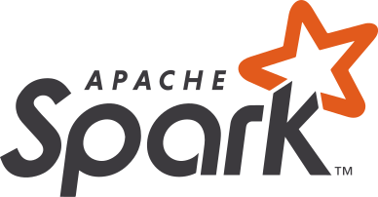
Azure Synapse Analytics
Integrated data platform for BI, AI and continuous intelligence
Artificial Intelligence / Machine Learning / Internet of Things
Intelligent Apps / Business Intelligence
Designed for analytics workloads at any scale
Synapse Analytics
SaaS developer experiences for code free and code first
Experience
Synapse Analytics Studio
Platform
Multiple languages suited to different analytics workloads
MANAGEMENT
Languages
MANAGEMENT
SQL
Python
.NET
Java
Scala
R
Integrated analytics runtimes available provisioned and serverless on-demand
SQL Analytics offering T-SQL for batch, streaming and interactive processing
Spark for big data processing with Python, Scala, R and .NET
SECURITY
Form Factors
SECURITY
PROVISIONED
ON-DEMAND
MONITORING
Analytics Runtimes
MONITORING
SQL
METASTORE
METASTORE
DATA INTEGRATION
Integrated platform services for, management, security, monitoring, and metastore
Azure
Data Lake Storage
Common Data Model
Enterprise Security
Optimized for Analytics
Data lake integrated and Common Data Model aware

Slide 2
Synapse Analytics Differentiators
Platform vs Point solution – Synapse is a platform with deep integration between the warehouse, dev tools, data lake, integration layer, and data science (ML Studio/Spark). This is a huge advantage for customers in terms of cost, complexity, implementation time, self-service BI, advanced analytics, and other downstream benefits. Snowflake is a DW point solution; Synapse is a holistic solution designed to work seamlessly to deliver much faster time-to-insight for data users.
Price/Performance – Because of concurrency limitations, Snowflake’s answer to infinite scalability is to add more clusters. They don’t have advanced optimization within each cluster (e.g., workload isolation) so they have to spin up new clusters to ensure performance for a given user or query. Synapse has a number of ways to allocate resources within (and across) clusters – a level of granularity beyond the capability of Snowflake. Moreover, to get all the advanced features of Snowflake, customers need their most expensive version (business critical) – a surprise customers discover only after production deployment. This is one of the reasons why a bunch of prominent Snowflake customers are getting rid of Snowflake and coming back to Synapse.
Optimization *IS* Required – Snowflake talks about how their product performs out of the box without optimization, yet complains the GigaOm TPC was not optimized. Weird. Synapse regularly beats Snowflake (and Google and Redshift) in performance benchmarks, both TCP and in individual customer POCs. While every customer is different, the fact that we provide a variety of facilities for tuning and optimizing queries, loads, and data distribution management. The result is that during POCs, we can demonstrate superior performance and *how we get there* rather than simply claiming that we perform optimally out-of-the-box. Snowflake makes that claim, but if that’s the case, why are they getting killed in TPCs?
Single vs. multiple tenants – Snowflake runs in its own tenant; Synapse runs in customers’ tenants. With Snowflake running in a separate tenant, customers will suffer penalties on security, latency, cost, development and time to implementation.
DBAs are Most Definitely Required – Snowflake still requires the customer to manage provisioning/monitoring clusters, debugging performance, managing users/groups/access control (including complex AD integration), setting auto-suspend, and cost containment.

Slide 3
Snowflake Objection Handling (30K-foot)
Data Warehouse “Built for the Cloud” – while Snowflake is a newer data warehouse offering and thus has been designed specifically with cloud deployment in mind, it lacks key technology and capabilities that Azure Synapse Analytics offers given its 20-year history in data support and integration with common tools and technology, enabling Azure Synapse Analytics to excel in price performance and addressing the full range of customer requirements. Example: no SQL support (JavaScript only)
Unlimited Concurrency – Snowflake preaches unlimited concurrency, but in order to scale past 8 concurrent queries, Snowflake requires customers to spin up additional clusters (more compute). This restriction means that for 400 concurrent queries, Snowflake would require 50 clusters, a very expensive way to scale and preventing cost predictability! By comparison, with the addition of Materialized Views and ResultSet caching, an Azure Synapse Analytics customer would need more than 10,000 unique concurrent queries to require additional capacity beyond what’s included out of the box.
No DBA required – The claims of simplicity made by Snowflake are either false or weak attempts to gloss over the missing features in their immature platform. While Snowflake automates basic DBA tasks, they still require the customer to manage provisioning/monitoring clusters, debugging performance, managing users/groups/access control, setting auto-suspend, and cost containment. More importantly, Snowflake’s lack of DBA tuning and optimization capabilities prevents users from obtaining promised performance for critical workloads, something customers often discover too late!
Security, for example, requires manual configuration in Snowflake. Although it is a one-off, customers should not underestimate the security configuration required. Added complexity increases the risk of errors made in implementation and may result in gaps in the implementation.
Multi-cloud Support – Snowflake supports Azure, AWS and Google today, and they tout this capability as a risk mitigation strategy for customers desiring to run analytics workloads seamlessly across clouds. However, running a single workload across multiple clouds adds significant complexity and cost overhead that is not obvious and tradeoffs should be fully understood. Azure provides the most comprehensive integrated stack for the entire modern data warehouse ranging from ingestion, through data lakes and warehouses, and up to cubes and visualization. Snowflake is only one piece of this solution and bridging across clouds creates fragmentation in the all-up analytics platform.
Data Sharing – Snowflake positions their capability to securely share data in-place among external parties as a key differentiator. However, Snowflake can only share data within its own proprietary format and thus is closed and inflexible. Azure Data Share, a recently developed feature of Azure Synapse Analytics, enables sharing of any data from a variety of sources securely within Azure. This means that Azure Synapse Analytics can share data as a snapshot across any non-Azure Synapse Analytics entity such as Open Source, Databricks, or ETL/ELT systems.

Slide 4

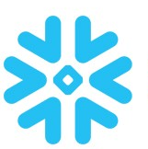
Feature summary
 | Synapse Analytics | Snowflake
Compute Properties
Separation of Storage and Compute | Yes | Yes
Elastic single cluster | Yes (Manual) | Yes (Manual)
Single cluster Workload Isolation | Yes | No
Multi-cluster | Mid-2020 | Yes (w/Auto-Scale)
Online Scaling | Mid-2020 | Yes
Max cluster concurrency | 128 | 8
Enterprise Class Data Structures
Replicated Tables | Yes | No
Table Partitioning | Yes | No
Non-clustered Indexes | Yes | No
Fast Load Heap Tables | Yes | No
Ordered Columnstore | No (Coming Soon) | Yes
Native Complex Type (JSON/XML) support | Mid-2020 | Yes
Materialized Views | Yes | Yes (Preview)
Resultset Cache | Yes | Yes
Programmability
Stored Procedures | Yes | No (Coming Soon)
Functions | Yes | Yes

Slide 5
Feature summary
 | Synapse Analytics | Snowflake
Pricing Model
Billing Granularity | Hour | Second
Reserved Capacity Discounts | Yes (March 2019) | No
Pay-as-you-go time (no pay-per-query) | Yes | Yes
Workload Management
Workload Classification | Yes | No
Workload Importance | Yes | No
Automatic Maintenance
Automatic columnar index optimization (no index rebuild required) | Yes | Yes
Automatic create & update statistics | Yes | Yes
Automatic backup | Yes | Yes

Slide 6
Feature summary
 | Synapse Analytics | Snowflake
Developer Productivity
1st class integrated development environment (Visual Studio) | Yes | No
Export schema to Database Project | Yes | No
One-click deploy with schema change script generation | Yes | No
Continuous Integration | Yes | No
Continuous Deployment | Yes | No
Security
Data encryption in transit | Yes | Yes
Data encryption at rest (Service & User Managed Keys) | Yes | Yes
Data Discovery and Classification | Preview Soon | No
Native Row Level Security | Yes | No
Table and View Security (GRANT / DENY) | Yes | Yes
Column Level Encryption | Preview Soon | No
SQL Authentication | Yes | Yes
Native Azure Active Directory | Yes
Integrated Security | Yes | Yes
Virtual Networks | Yes | Yes
Firewall | Yes | Yes
Threat Detection | Yes | No
Auditing | Yes | No
Vulnerability Assessment | Yes | No

Slide 7
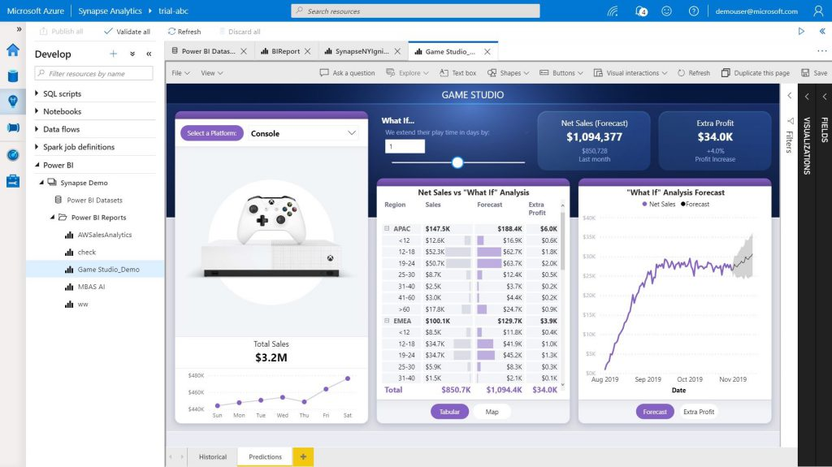
Synapse native integration with PowerBI
Customers can link Power BI and Azure Synapse workspaces together providing them with a single pane of glass to develop and manage their end to end analytics infrastructure.
BI professionals can create enterprise grade semantic models from the Synapse workspace through integration with Power BI Desktop – which helps customers define their KPIs and business logic, apply role based security, and provides a blazingly fast in-memory cache.
Customers can build Power BI reports directly from within the Synapse workspace and make these reports available to their end users.

